Slide 1
Text Mining Studio ETDs
Hannah Brinkley
Robert Rielage
Jason Vaanjilnorov
Christian Dy
CS 4624: Multimedia, Hypertext, & Information Access
Professor Edward A. Fox
Virginia Tech, Blacksburg, VA 24061
05/05/2020
Notes:
Hannah

Slide 2
Outline
Project Review
Project Design
Deliverables
Project Demonstration
Challenges
Timeline/ Workflow
Extensibility
Acknowledgements
References
Questions
Notes:
Hannah

Slide 3

Project Review
ETDs: theses and dissertations that have been converted into electronic documents
Ideal to used for data analytics, text mining, etc.
Building a centralized tool for analysis of these ETDs
Provide user-friendly interface for researchers to perform analysis
Notes:
Hannah

Slide 4
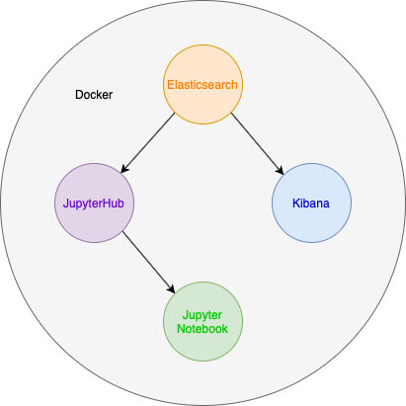
Project Design
ElasticSearch data library backend
Jupyter Notebook IDE frontend
To query and analyze ElasticSearch data
JupyterHub acts as the launch point for the software system
Docker containerizes all parts of the software
Easy deployment across systems
Kibana provides visualization of the data within ElasticSearch
Notes:
Hannah

Slide 5



Deliverables
The full-text from corpus of ETDs, indexed in ElasticSearch
A working JupyterHub environment that will allow users to query and work with the data stored in ElasticSearch in a Python Jupyter Notebook
Documentation, installation scripts, and Docker containers for project components
Indexed in a GitHub Repository
Notes:
Hannah

Slide 6
Project Demonstration
Please watch the Demonstration video (TextDataMiningStudioETDAnalysisToolDemonstration.mp4)
This video can also be found at the following URL: https://www.youtube.com/watch?v=90Q8FFhjfkI
Notes:
Robert

Slide 7
Challenges
COVID-19 communication complexities
Anaconda auto-update issues
Reduced ease of deployment
Failure to accomplish document ingestion in meaningful quantities
Overlap with existing efforts
Notes:
Robert

Slide 8
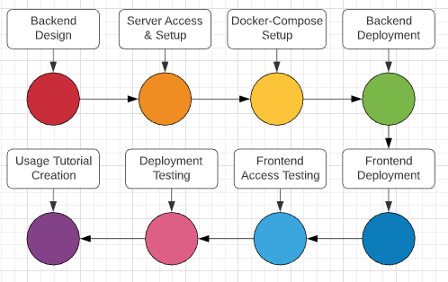
Workflow Timeline
Notes:
Jason

Slide 9

Extensibility
Better Kibana implementation
Complete document ingestion
More sophisticated user tutorials
Notes:
Jason

Slide 10
Acknowledgements
Client: Bill Ingram, Asst. Dean and IT Director, University Libraries
waingram@vt.edu
IR server access and navigation
Docker Compose tutorial
Dr. Edward A. Fox
Providing graduate student contact information
Providing access to VT git group with access to Kibana
Funding
IMLS LG-37-19-0078-19
Notes:
Jason

Slide 11
References
2020Project-TextDataMiningStudioETDs
https://canvas.vt.edu/courses/104585/pages/2020project-textdataminingstudioetds
Docker JupyterHub Package
https://hub.docker.com/r/jupyterhub/jupyterhub/
Collection Management of Electronic Theses and Dissertations (CME) CS5604 Fall 2019
http://hdl.handle.net/10919/96484
British Libraries Humanities Workbench Elasticsearch Repository
https://github.com/BL-Labs/hwb_elasticsearch
Notes:
Jason

Slide 12
Questions?

